Slide 1
Mission 3 Remix
Create your own project from Mission 2 and Mission 3

Slide 2

Pre-Mission Preparation
In the Mission 3 Remix Log, answer the pre-mission preparation questions:
What are some things you have learned to do with the CodeX?
What does a ‘remix’ mean to you?

Slide 3
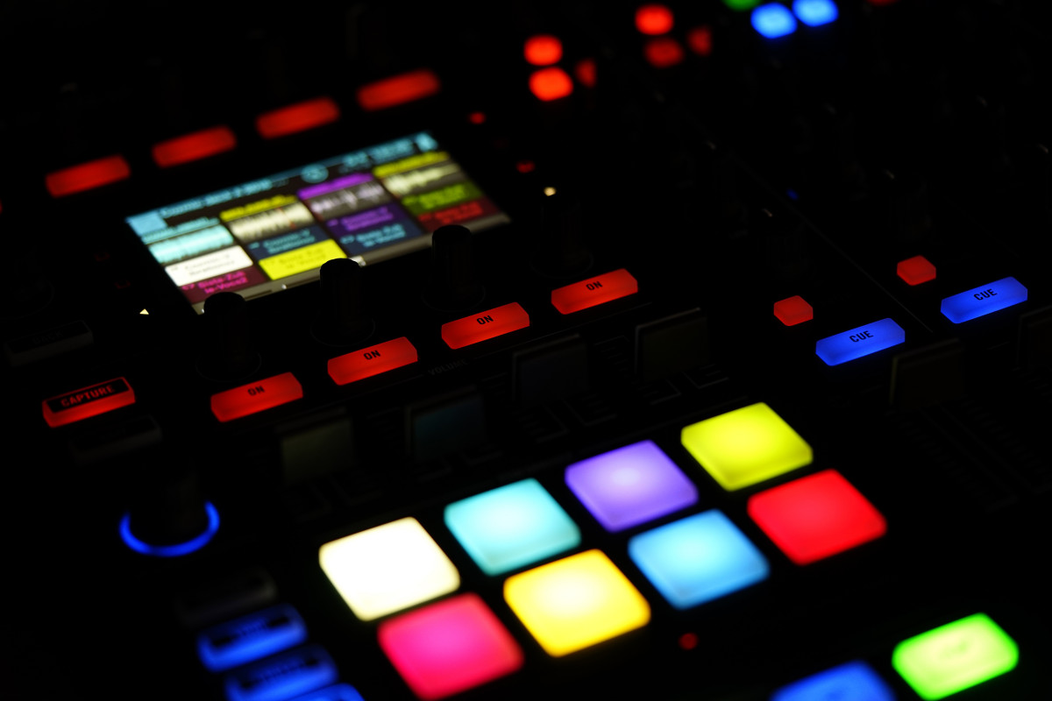
Have you heard of music remixes?
It is when someone takes parts of a song, or several songs, and combines them with some original music to create something original
You can combine two or more songs as part of a remix
Something new is created by combining parts of songs and adding new music with the parts

Slide 4
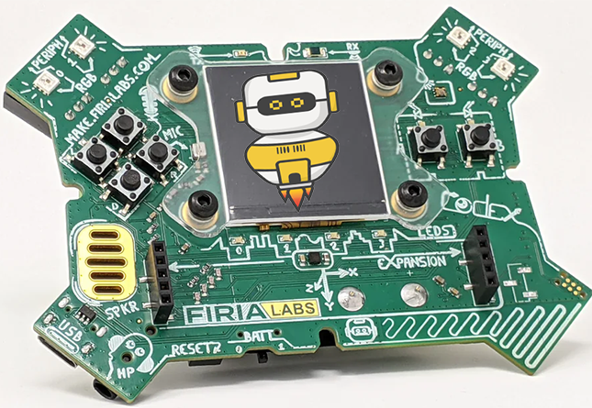
Project Remixes
You can do the same thing with your mission projects!
A new program is created by adding new code and using parts of code from programs you already created
You can combine parts of two or more programs in a remix

Slide 5
Project Remixes
Creating a remix of your projects will let you:
Use the skills and practice the concepts from the missions
Be creative
Improve your understanding of programming
Collaborate with other students
Design an original program and write the code all on your own

Slide 6
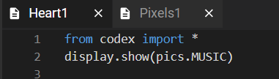
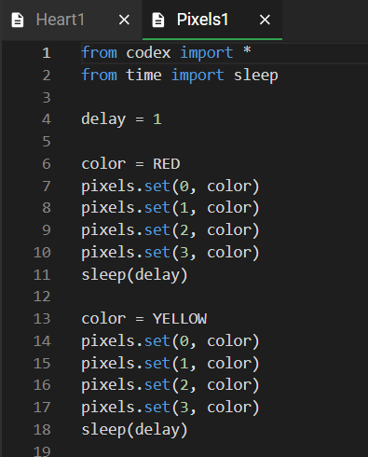
Step #1
Review projects and concepts
Open your projects from
Mission 2 & Mission 3
  Review what the program does
  Review the programming concepts and skills used
DO THIS:
Fill out the information in the Mission 3 Remix Log for Step 1

Slide 7
Step #2
Brainstorm ideas
For this first remix, you will use RGB to display different colors.
Follow the information on the next section of slides
Learn about RGB (red, green, blue)
See how to use RGB to display any color
Then use RGB in your remix

Slide 8
CodeX and RGB
Setting pixels to any color using RGB tuples

Slide 9
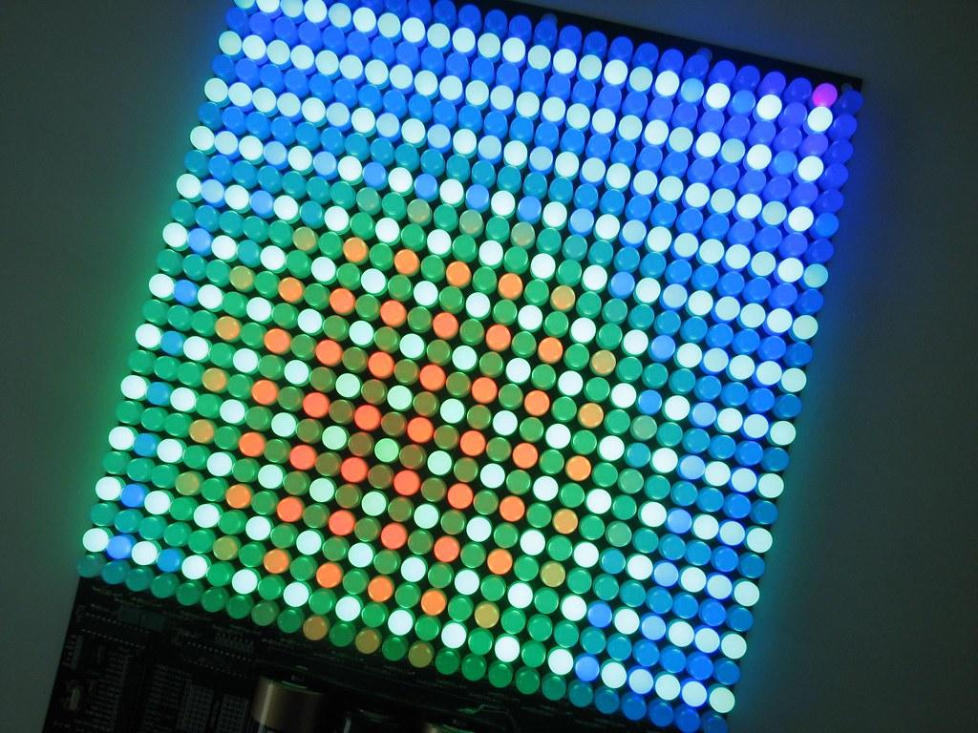
What is RGB?
RGB stands for Red, Green, Blue.
Find out more by watching one of the short videos on the next slides.

Slide 10
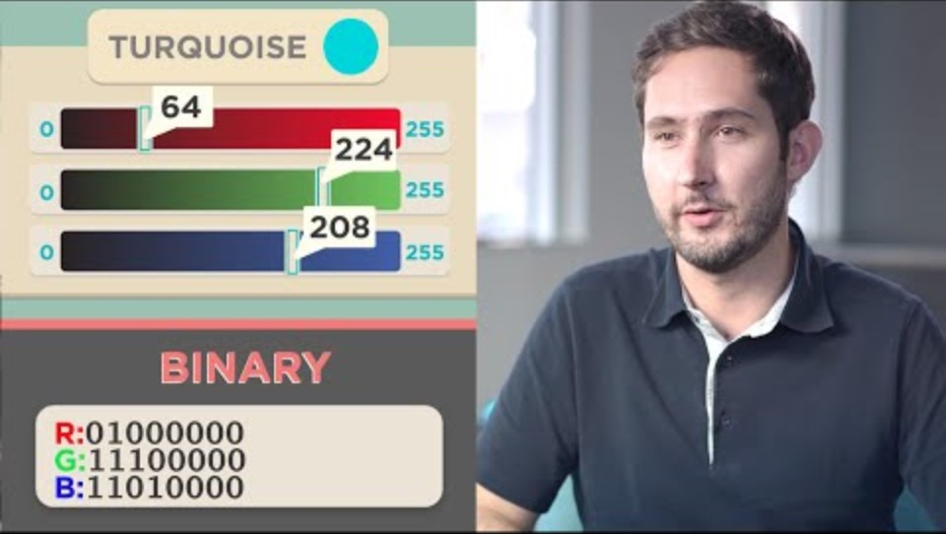
Code.org video on pixels
Watch from
0:45 to 2:35

Slide 11

Getting RGB values
The video mentions “triplets” of numbers. Each number in the triplet represents a value in RGB.
= ( 47, 147, 181)
The first number is the amount of red
The second number is the amount of green
The third number is the amount of blue

Slide 12
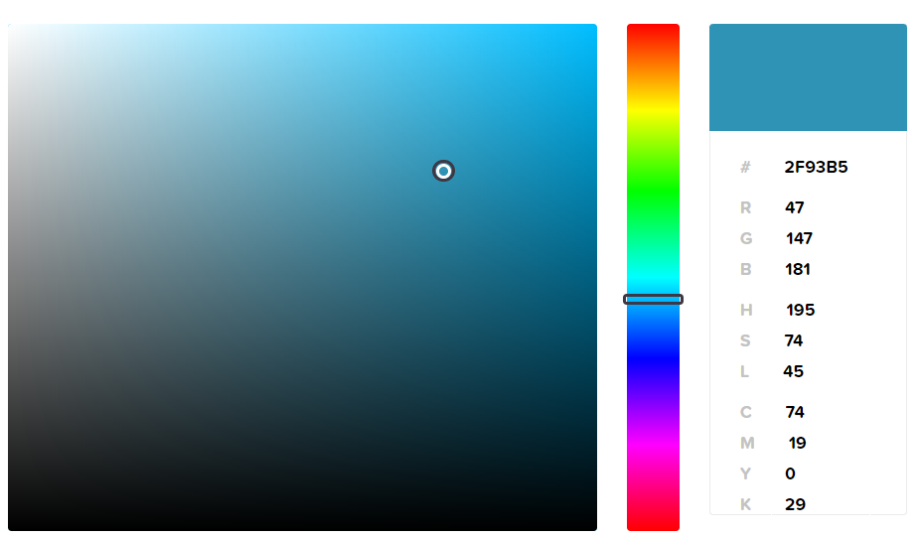
Getting RGB values
Use online software to select a color and find the RGB colors.
( 47, 147, 181)
In Python, the triplet is called a “tuple”
Online color picker: https://htmlcolorcodes.com/color-picker/

Slide 13
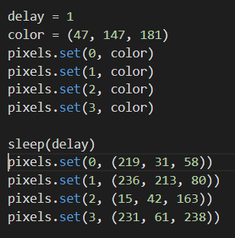
Using RGB values
Set your own colors by changing the color value to a tuple instead of a built-in color:
color = (47, 147, 181)

Slide 14
Using RGB values
You can also assign each pixel their own color by using the tuple in the pixels.set() function

Slide 15
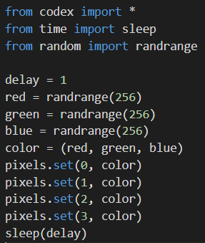
Challenge:
Random RGB values
If you want to try something new, generate random numbers for R, G and B and see what color happens!
Everytime you run the code, or add the code multiple times, you should get a different color.

Slide 16

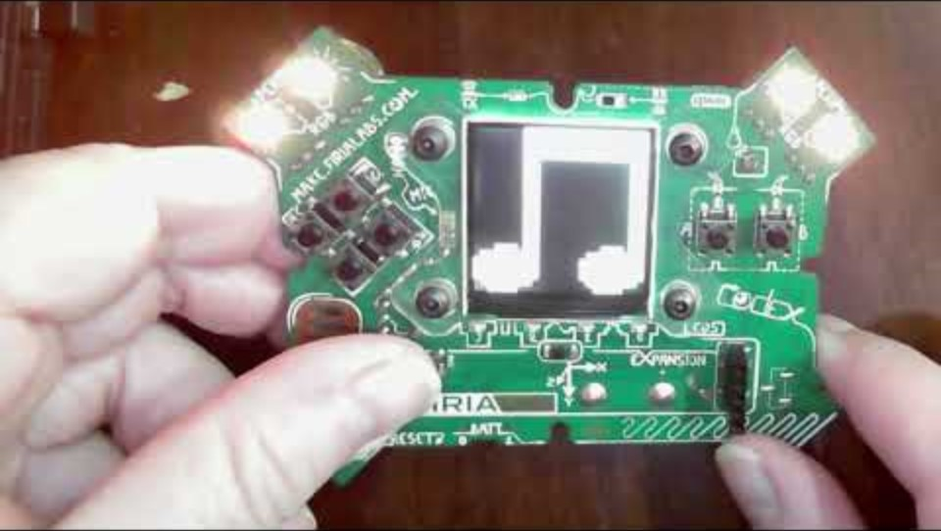
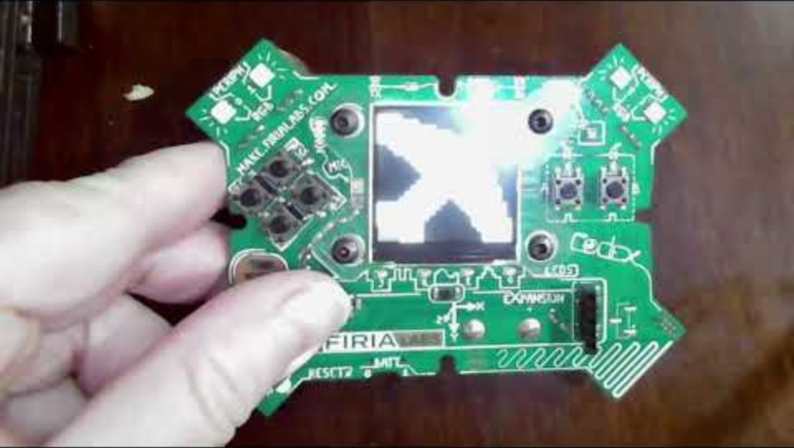
Step #2 Remix Ideas
Mild
Select an RGB color for all four pixels and display an image. After a short delay, select a different RGB color and image. Repeat as many times as you want. Slide 14 can help you.
Medium
Light all pixels with an RGB color. Then turn off the pixels and display an image. Then clear the screen and light the pixels with another RGB color. Repeat as many times as you want.
Hint: use display.clear() and
pixels.set(#, BLACK)

Slide 17
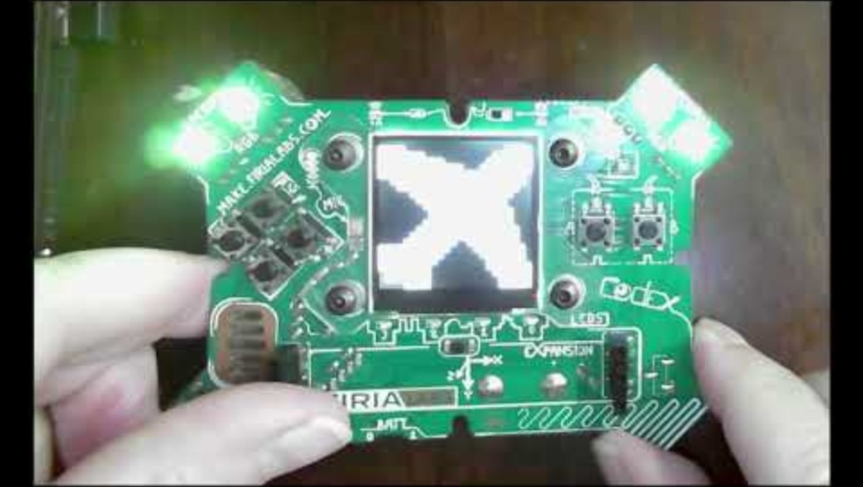
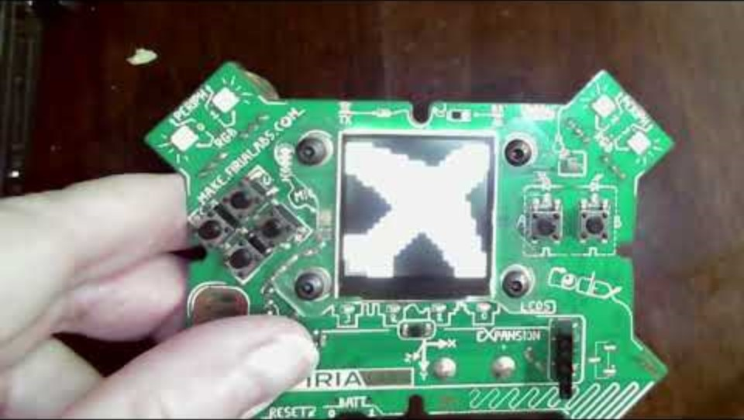
Step #2 Remix Ideas
Spicy
Use one of the ideas from Mild or Medium, but instead of using an RGB color that you chose, use random colors. Slide 16 can help you.
Mild with random colors
Medium with random colors

Slide 18
Step #2
Brainstorm ideas
Read through remix suggestions from your teacher (previous slides)
Use your creativity to come up with your own idea for a project
How can you use RGB colors in your remix project?
Decide with your partner what project you will do
DO THIS:
Fill out the information in the Mission 3 Remix Log for Step #2

Slide 19
Step #3
Make a plan
What variables will you need?
What colors will you use?
What images will you display?
DO THIS:
Fill out the information in the Mission 3 Remix Log for Step #3

Slide 20

Step #4
Code your project
IMPORTANT: Go to the sandbox to code the remix project
  Above toolbox in the lower left corner
Start with a new file and give it a descriptive name (Remix3)
You can leave Heart1 and Pixels1 open (Use them as a guide)
Import your modules
Define your variables
Write your code, testing frequently

Slide 21
Step #4
Stop and test frequently!
Don’t try to write all the code at one time
Mistakes happen, so find them early
Type just a few lines of code and then run the program
If there is an error, fix it before continuing
Use the debugger and your other programs for help

Slide 22
Step #5
Documentation!
Make sure your code is readable by adding blank lines
Add comments to sections of your code that explain what they do

Slide 23
Step #5
Get feedback
Show your code to other students
What do they think? Have them fill out the feedback form on your Mission 3 Remix Log
Give yourself some feedback Is there something you want to change or improve or add? Fill out the feedback form on your Mission 3 Remix Log
Modify your code to make your project even better

Slide 24

And now you have your own remix!
Congratulations!
By completing this remix you have:
learned more about programming
used skills and concepts from the missions
been thinking! And problem solving and much more!

Slide 25
Post-Mission Reflection
Wow! Great job!
Share your project with your friends!
Complete the Mission 3 Remix Log
Don’t forget to clear your CodeX by running your Clear program

